Slide 1
Everything you wanted to know about DACS but were afraid to ask
Administrative hearings

Slide 2
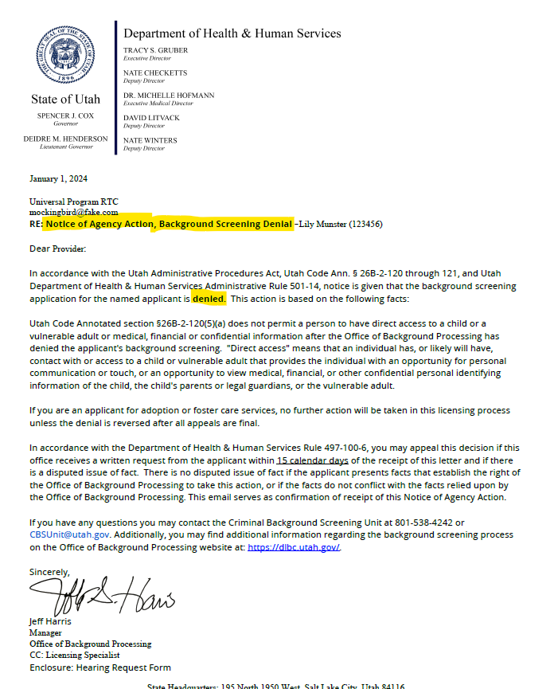
Notice of Agency Action - Background check denial
There are 2 different types of background check denial letters:
Mandatory denial
Comprehensive Review Committee/Director denial
Notes:
There are two different types of background check denial reasons:
Statutorily Mandatory denial
Per Utah Code 26B-2-120 subsections (5) and (13) there are convictions that, with specific qualifications, are not eligible for approval.
Comprehensive Review Committee and Director Review denial
Per Utah Code 26B-2-120 subsection (6) our Office is required to review criminal and non-criminal findings and make a determination based upon the assumption of risk of harm to the vulnerable populations served by DHHS.
To comply with FBI dissemination laws, providers will receive the same template letter, shown in the graphic, for either type of denial. *Please note that this is the only type of denial letter sent to the provider, any other letters sent by the OBP should be carefully read as they are likely seeking information.
The applicant will receive a separate letter with the specific disqualifying reasons and history outlined.
The denial letter will typically be two to three pages with the last page being a hearing request form.

Slide 3
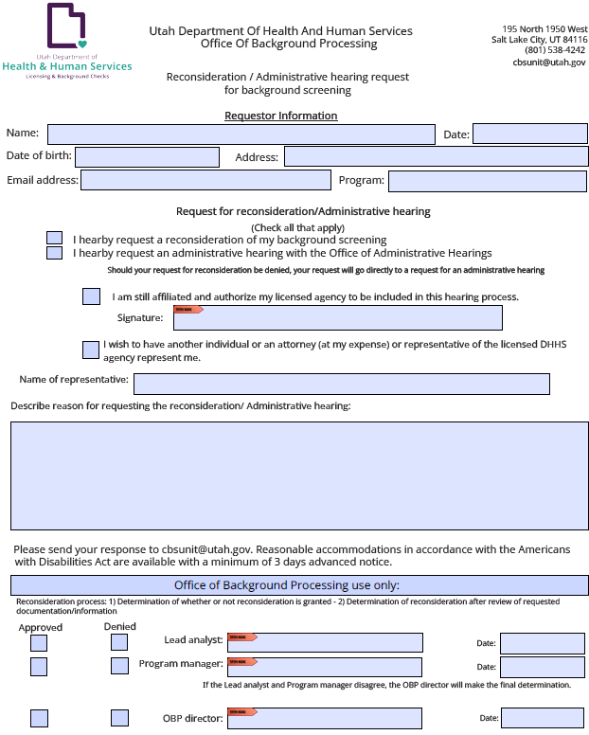
Administrative hearings
Utah Code R497-100-6 allows an applicant to request an administrative hearing if they believe OBP did not conduct the background check in accordance with statute and rule.
This form will be included in the notice of agency action letter sent to the applicant.
Notes:
Utah Code R497-100-6 allows an applicant to request an administrative hearing if they believe OBP did not conduct the background check in accordance with statute and rule.
This request for administrative hearing must be submitted to the OBP within 15 calendar days of the denial letter email.
Upon receipt of the request for hearing, OBP will create a hearing packet and forward the following information to the Office of Administrative Hearings (OAH):
A copy of the denial letters sent to the provider and to the applicant
The applicant’s request for administrative hearing
And, if applicable, a Motion to Dismiss the requested hearing.

Slide 4
Administrative hearings packet
The Office of Background Processing (OBP) is responsible to provide evidence that:
The background check was processed according to rule and statute
Justifies the determination
Evidence provided for the hearing includes:
Documentation submitted by the applicant
Research and documentation submitted by the OBP analyst
The OBP may request a motion to dismiss if the proper criteria for the hearing is not met.
Notes:
OBP will request a motion to dismiss if the hearing request is:
A mandatory denial per utah code 26B-2-120(5); or
The request is not made in a timely manner (within 15 calendar days); or if
The applicant is no longer associated with the licensed agency.
Please note: this hearing process exists to make sure OBP follows all the correct processes and procedures and is not another attempt to show why the applicant should be allowed to work.

Slide 5
Expungement or non-criminal history changes
OBP and OAH are not able to assist with expungements, dismissals, or changes to criminal and non-criminal history.
Please consult legal advice/support for help in these areas.
Notes:
The applicant will need to contact the Department of Public Safety for expungement proceedings for criminal history and the applicable Department of Health and Human Services division for changing a determination for supported findings in investigations.

Slide 6
Statute and rule
OBP reviews the following criteria when processing a background check:
26B-2-120 and
R501-14

Slide 7
Administrative hearings
Questions about DACS?
Call: 385-239-5538
Email: dhsdacs@utah.gov
Questions about background processing?
Email: cbsunit@utah.gov

