Slide 1
Everything you wanted to know about DACS but were afraid to ask
DACS User Accounts

Slide 2
Access to DACS
screening agent
Every program needs one employee responsible for entering, verifying, and separating applicants in DACS.
This employee is referred to as the screening agent.
The screening agent is the liaison between the Office of Background Processing (OBP) and your programs.
The screening agent is the only DACS Admin User.
DACS username(s) and passwords are not to be shared. If this occurs, DACS access will be revoked.
Notes:
Per Utah Administrative Rule 501-14-2(27)
(27) "Screening Agent" is the individual or individuals who are responsible for initiating, monitoring and maintaining background clearance communications with the Office, entering applications, verifying and protecting personally identifying information and ensuring information is current for their agency, applicants and providers in the online system.
We will train the Screening Agent on DACS.
Programs may have more than one DACS User but only one DACS admin user.
Best practices: programs have one screening agent, usually an administrative position to contact and work with the office. The program may have multiple DACS users to help with the DACS responsibilities., if necessary. Screening agents are the only contact between OBP and the program.

Slide 3
DACS users
Office staff or others with the program who can help enter, verify, and separate applicants are DACS users.
DACS users (just like screening agents) must:
Be entered into DACS
Have an eligible determination
Be associated with your program
DACS username(s) and passwords are not to be shared. If this occurs, DACS access will be revoked.
Notes:
For DACS Users, the Screening Agent is responsible for training.
If necessary, each program can create, manage, and train additional users.
Best practices: when setting up a DACS User do not give them grantable access.
Only the screening agents should have the permission to create other DACS Users.

Slide 4
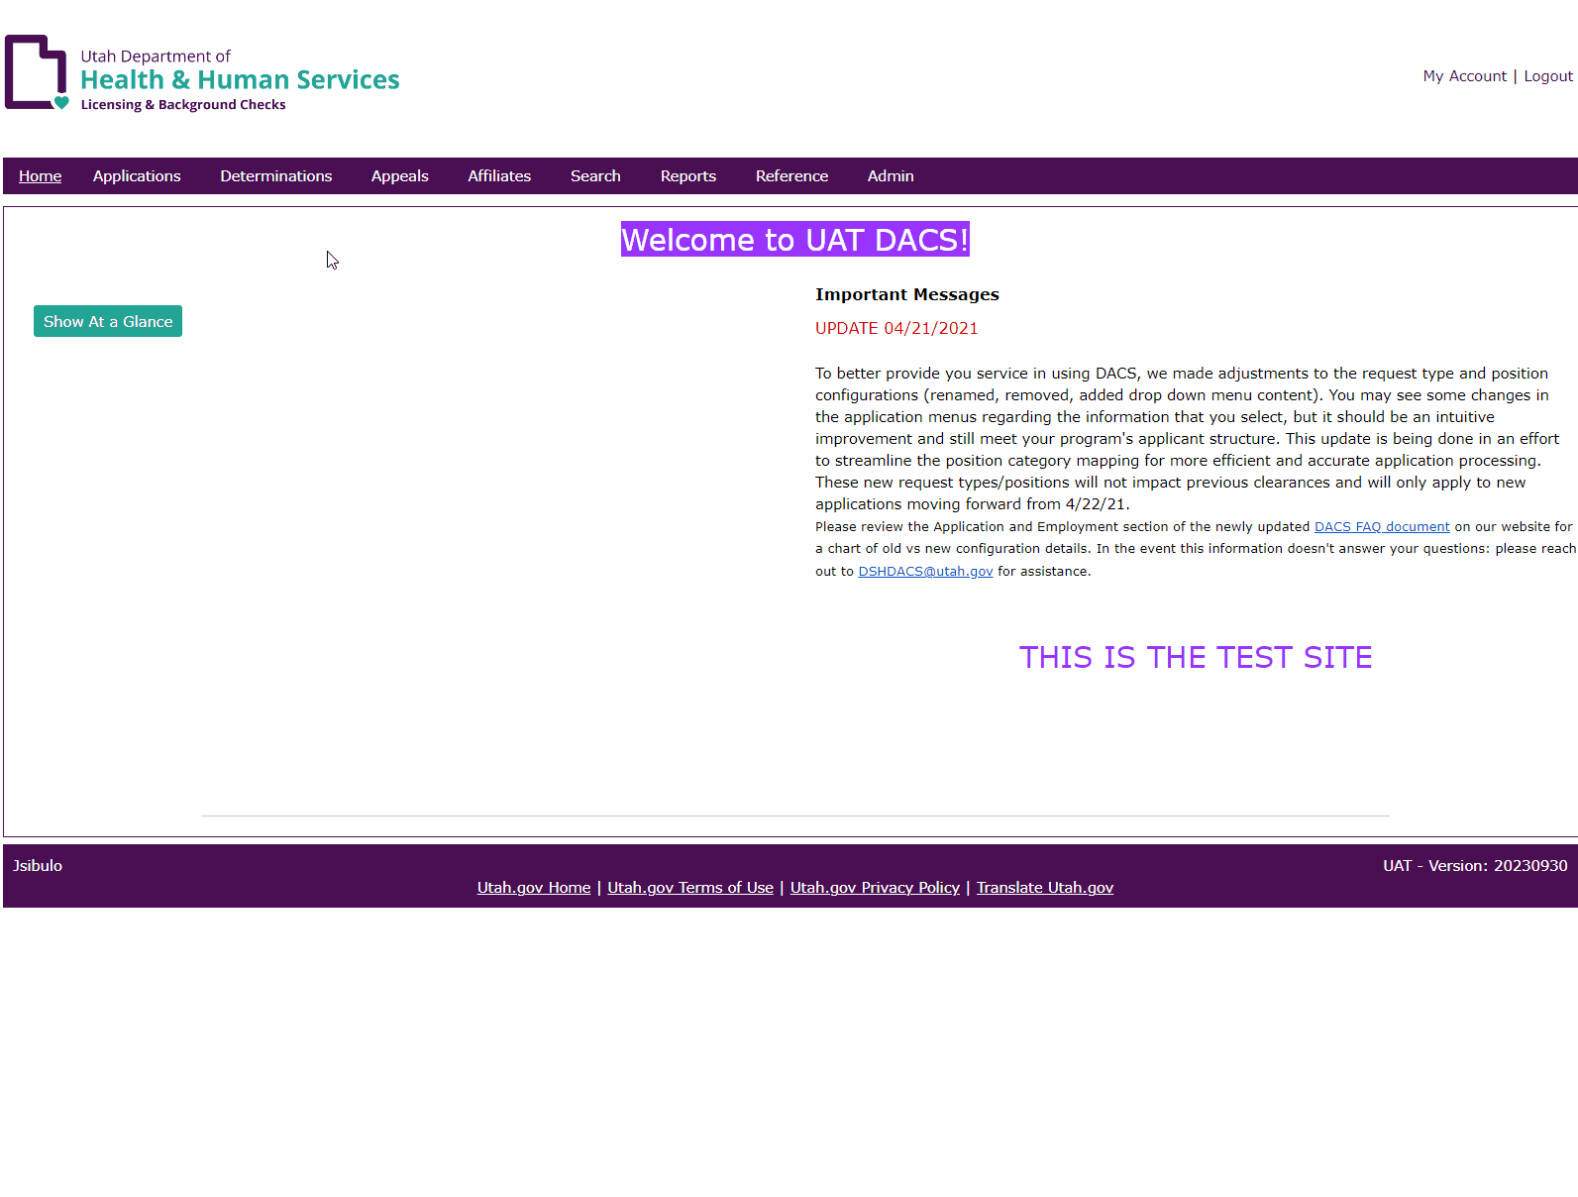
DACS username(s) and passwords are not to be shared. If this occurs DACS access will be revoked.
Creating a DACS User Account
Notes:
The easiest way to create a DACS user is to go to the roster and under actions add user.
The following determinations cannot be DACS users:
-Eligible supervision required
-Eligible missing disclosure
-In Process
-Closed
-Not Eligible
If you create the account you are responsible for training and managing the user of the account.

Slide 5
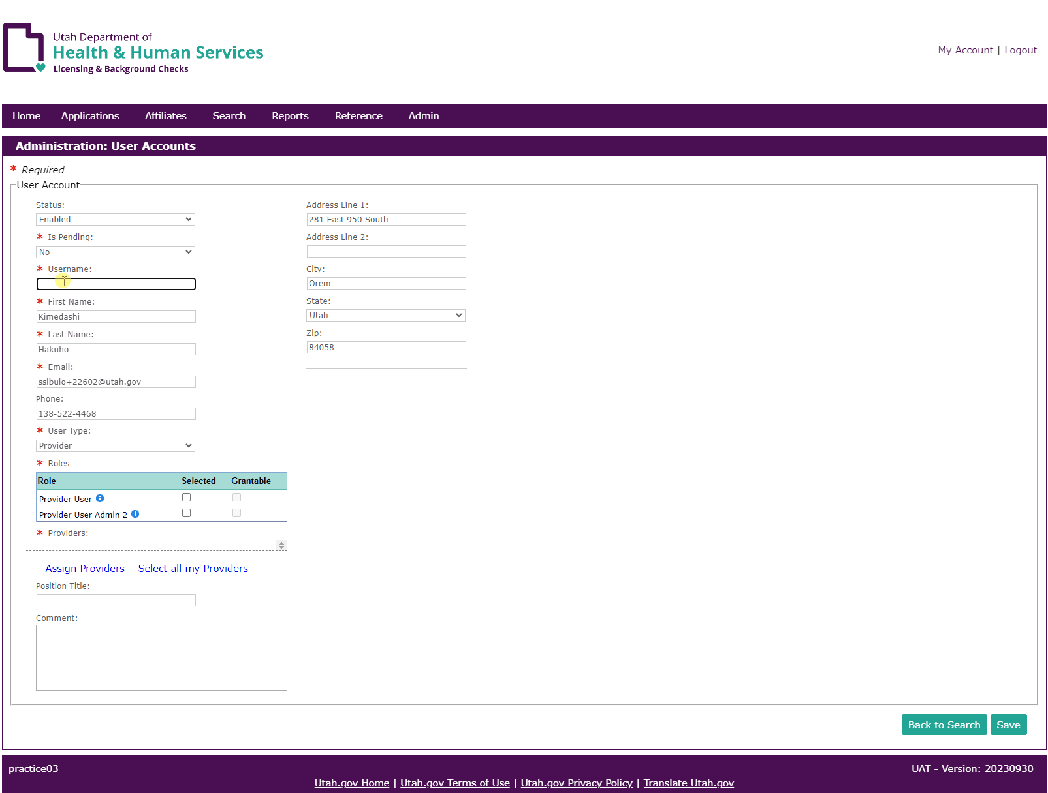
DACS username(s) and passwords are not to be shared. If this occurs DACS access will be revoked.
Creating a DACS User Account
Notes:
This slide Administration: User Accounts and selecting the dropdowns and roles
Usernames need to be specific to the individual assigned.
Best case is an email that contains the users name
A generic login is not acceptable
These emails are not to be to a delegated inbox
An account belongs to one person. Not to be changed. Editing the name does NOT make it a new user’s account.
This is a time for you to verify this information is correct for this user
-Email
-Phone
-Title
Once saved the user will be sent a temporary password. This password is valid for 7 days.

Slide 6
Disabling accounts
DACS screening agents are responsible for the management of the user accounts for their program.
User accounts need to be disabled when:
A determination is anything but “Eligible”
User left the program
User role changes
DACS username(s) and passwords are not to be shared. If this occurs DACS access will be revoked.
Notes:
Unused accounts will be auto disabled after 3 months of inactivity.

Slide 7
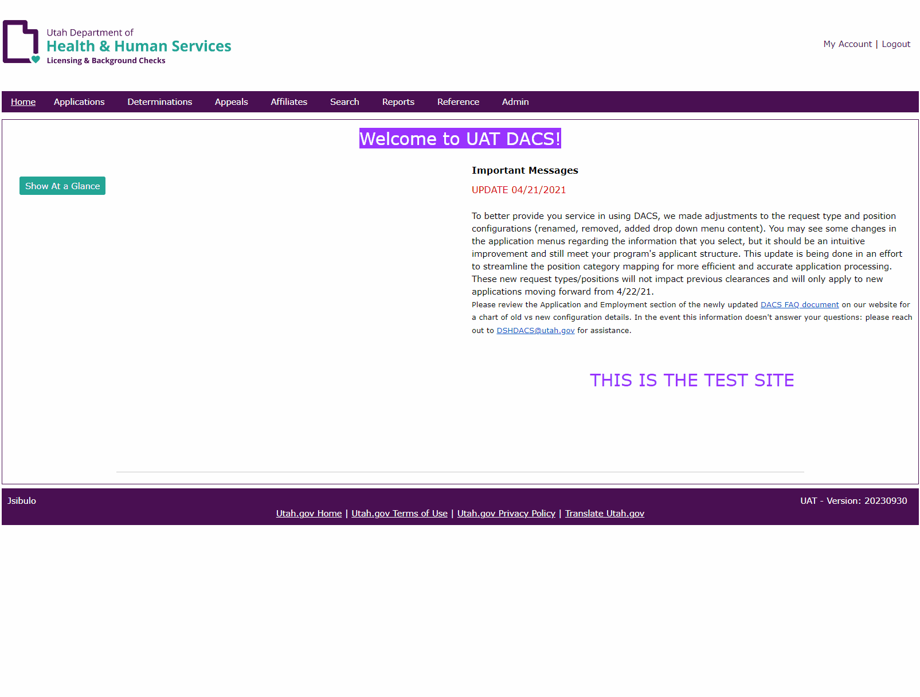
DACS username(s) and passwords are not to be shared. If this occurs DACS access will be revoked.
Disable a User Account
Notes:
Create a Gif
Admin→ User Account→User to disable
Best practice is once an employee gives the 2 weeks notice to disable them

Slide 8
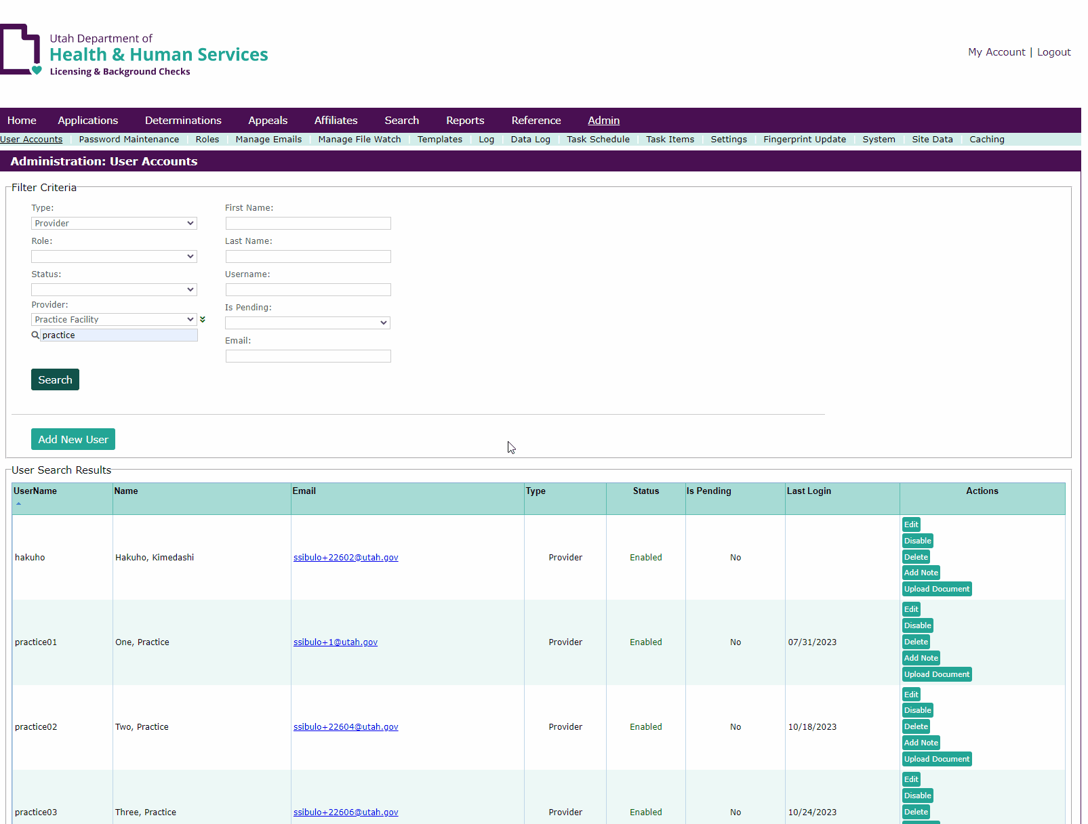
DACS username(s) and passwords are not to be shared. If this occurs DACS access will be revoked.
Disable a User Account
Notes:
Create a Gif
Then the rest of the instructions when they find the user to disable

Slide 9
DACS user accounts
Questions about DACS?
Call: 385-239-5538
Email: dhsdacs@utah.gov
Questions about background processing?
Email: cbsunit@utah.gov

