Slide 1
DACS training
New process for position categories
May 3, 2023
Notes:
Copy this template before editing. Do not edit the Template.

Slide 2
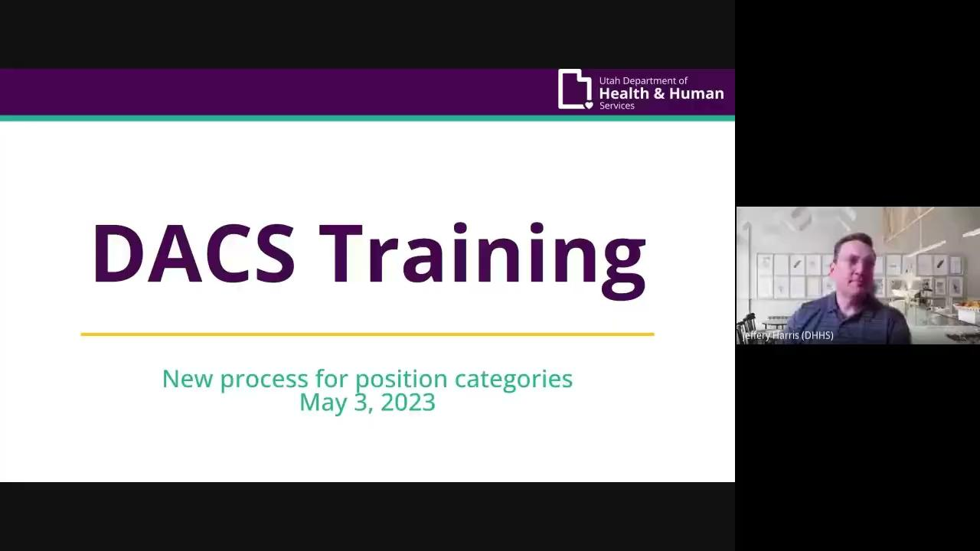
Video Presentation
If you cannot view the video please use this link:
New Hire Categories Video

Slide 3
New position types: 26B-2-120
Mental Health Professional
Peer Support Specialist
Serves Only Adult
Notes:
Peer Support Specialist: Has a disability or a family member with a disability, is in recovery from a mental illness, or a substance use disorder, and uses personal experience to provide support, guidance, or services to promote resiliency and recovery. Includes a certified peer support specialist
Mental Health Professional: Licensed with DOPL and engaged in the practice of mental health therapy
Program Serves Adults Only: with a primary mental health diagnosis, with or without a co-occuring substance use disorder
VS. Adults Only Substance Use Disorder Program
Position Description-Job Title or description with Organization

Slide 4
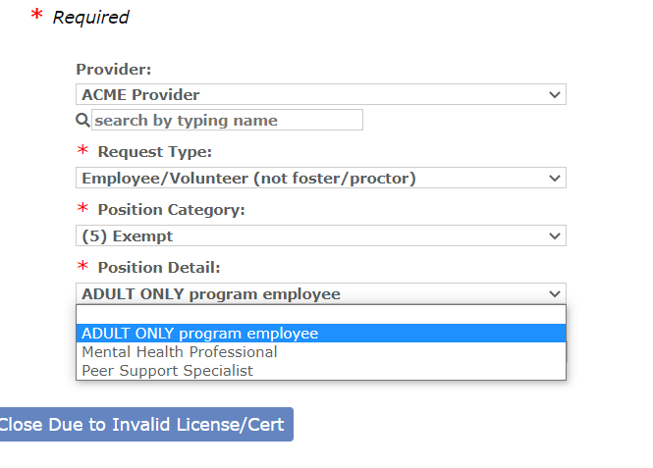

Slide 5
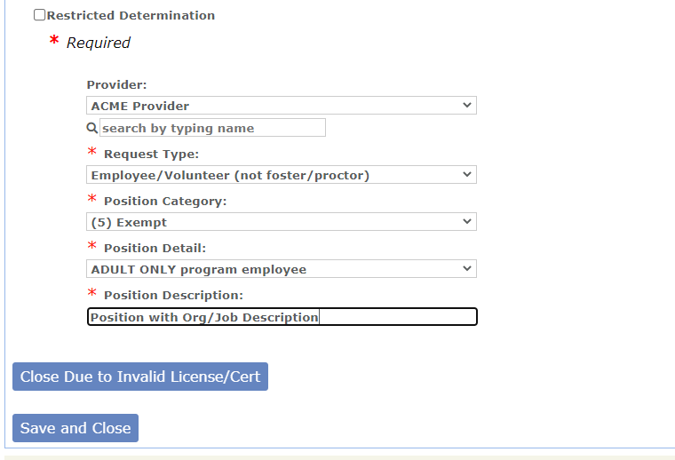

Slide 6
cbsunit@utah.gov
dhsdacs@utah.gov
Notes:
Copy this template before editing. Do not edit the Template.

