Slide 1
Everything you wanted to know about DACS but were afraid to ask
Verification and renewal

Slide 2
How does a renewal work?
Utah Administrative Rule 501-14 requires screening agents to verify the roster monthly.
Why do we need to complete a renewal?
Notes:
Utah Administrative Rule 501-14 section 4 requires the screening agent to check the roster at least monthly to verify employment and initiate the renewal process of individuals still associated with your program.
Verification includes confirming that the applicant’s name, address, email address and all other information is up to date.
Doing this on a monthly basis helps break down the task of keeping your roster up to date into manageable pieces.
We have broken down the renewal process into three steps:

Slide 3
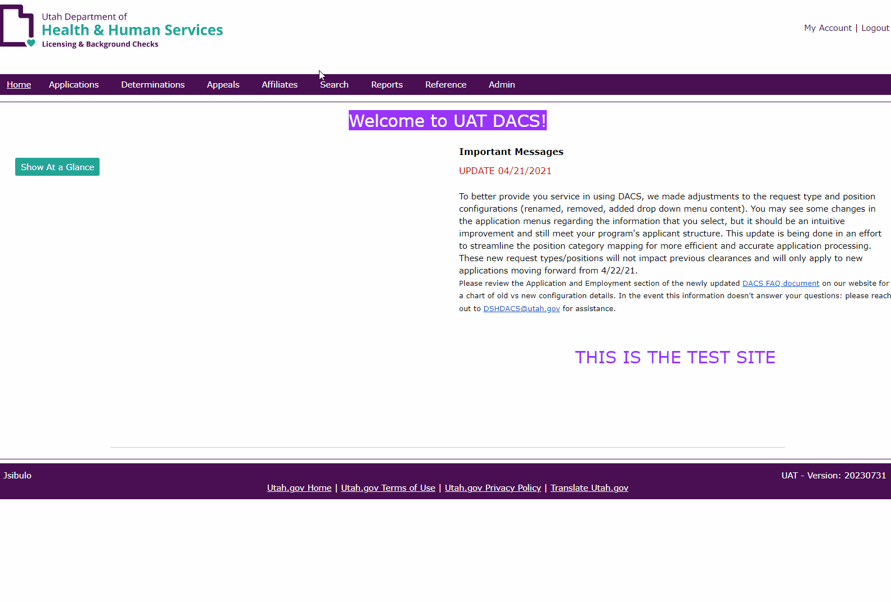
Monthly verification
Notes:
How do I find who is due for verification and renewal this month?
Affiliates (header menu) → Verification (drop down menu)
May search utilizing the date fields or by removing all date fields and sort by the ‘verification needed by’ column
You may also separate terminated employees utilizing the ‘edit’ option in the actions column.
Once you have a list of those that are in need of renewal for this month, complete step one.
Please keep a note of the names and applications numbers you will renew. You’ll need this.

Slide 4
What portion of the renewal process is my responsibility?
Step 1: Confirm the applicant profile information.
Name changes (including aliases)
Addresses (physical and/or mailing)
Employment status
Position title
Email address
This is the time to make corrections or updates.
Notes:
Name changes could include marriage, divorce, adoption, legal changes, etc.
Address changes should be updated at this time too.
Please verify that the email address is correct – this is our primary method of communication with the applicants.
Step one: Confirm the applicant profile information.
After identifying which applicants on your roster are due for renewal in the next month or the next 30 days, check each DACS profile to confirm the information listed is current and accurate.
This includes the applicant’s name, mailing address and email address and other employment information.
Best practice would also include double checking that there is a completed disclosure survey or uploaded disclosure form with your program

Slide 5
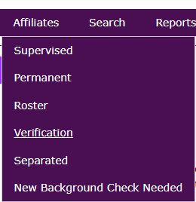
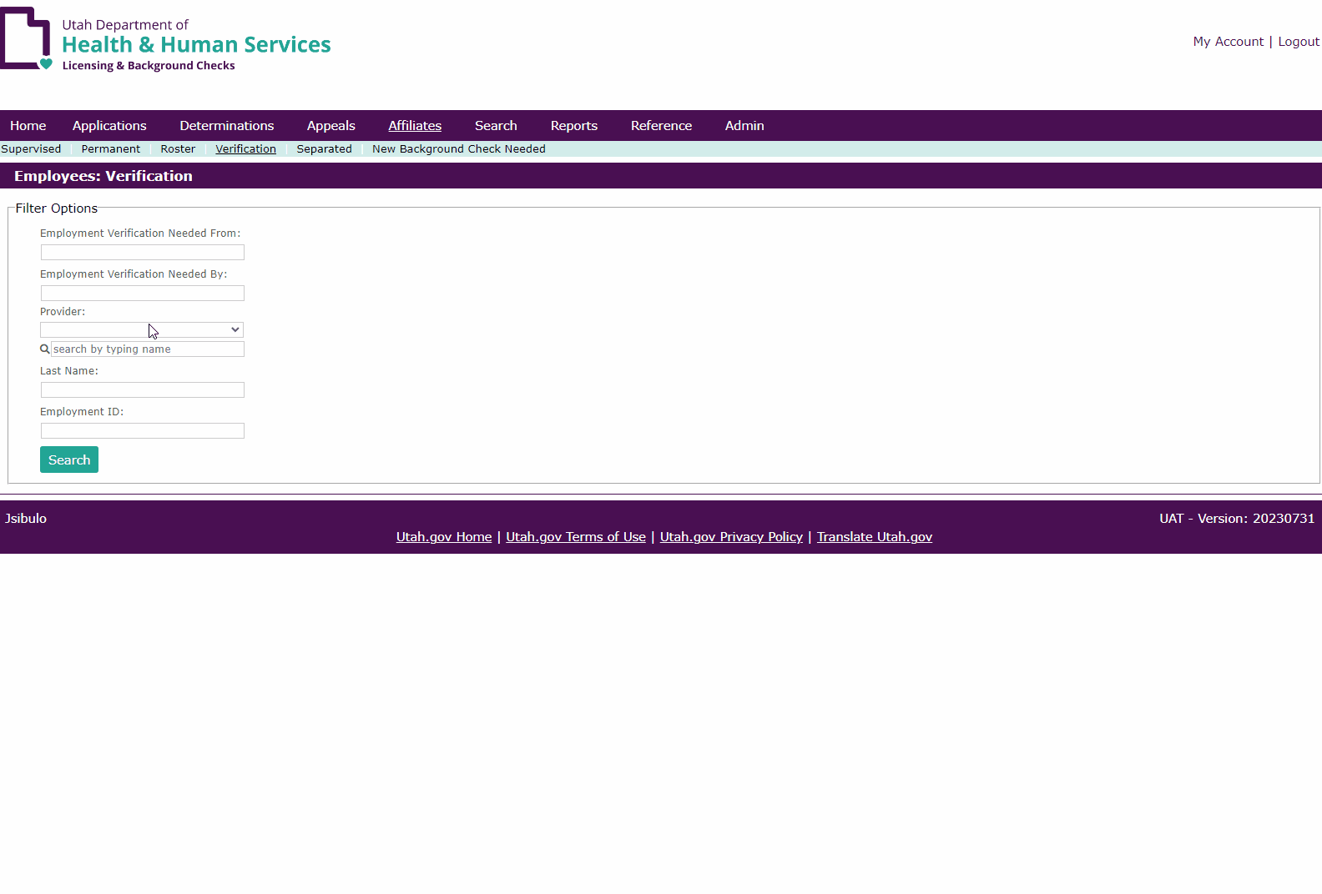
What portion of the renewal process is my responsibility?
Step 2: Verify the applicant in the DACS verification queue.
Notes:
Watch the pretty pictures.
Step two:
Be sure to select the box and click ‘verify selected’ to complete this step

Slide 6
What portion of the renewal process is my responsibility?
Step 3: Email the team at cbsunit@utah.gov with the applicant name and application number requesting renewal.
Notes:
Remember the names of the folks you renewed earlier? You’ll need the names and application numbers of the individual(s) now. Email them to: cbsunit@utah.gov
Step three: Email the team at cbsunit@utah.gov with the applicant name and application number requesting renewal
Please only email us AFTER completing steps one and two to avoid delays in processing your request

Slide 7
Verification and renewal
Questions about DACS?
Call: 385-239-5538
Email: dhsdacs@utah.gov
Questions about background processing?
Email: cbsunit@utah.gov

